Slide 1
What are Genome Browsers?
Graphical interface for users to browse, search, retrieve an analyze genomic data
Data include variation, transcription, regulatory data such as methylation, transcription factor binding and disease associations
Some of the larger genome browsers also serves as data archives for public datasets
It is also possible to load your own data into some of the public genome browsers
Some of the genome browsers commonly used are:
The UCSC Genome Browser
ENSEMBL Genome Browser
Epigenome browser at WashU
Integrative Genome Browser (IGV)

Slide 2
UCSC Genome Browser
The University of California Santa Cruz (UCSC) Genome Bioinformatics website consists of a suite of free, open-source, on-line tools that can be used to browse, analyze, and query genomic data
The website provides a quick and easy-to-use visual display of genomic data
A few among the suite of tools available in UCSC are:
BLAT – Pairwise sequence alignment
LiftOver – Converts genomic coordinates and annotations between assemblies
Variant Annotation Integrator – Add functional annotations to variant calls
Can download data – genomic annotations, sequence files, alignments + data from tracks/browser – Table browser

Slide 3
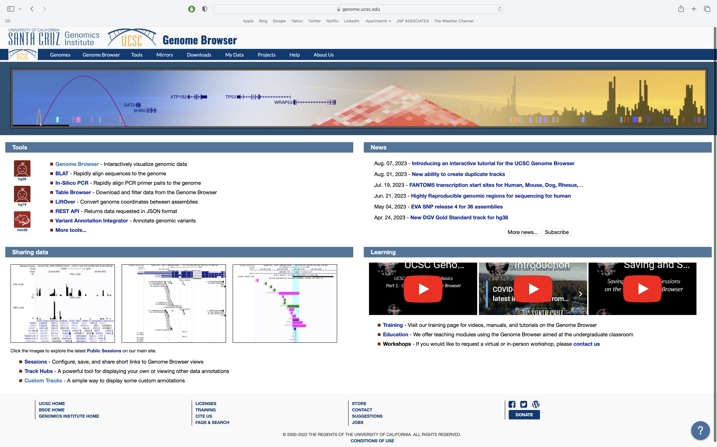
Open the University of California Santa Cruz genome browser website: https://genome.ucsc.edu/

Slide 4
Click on ‘Genomes’

Slide 5
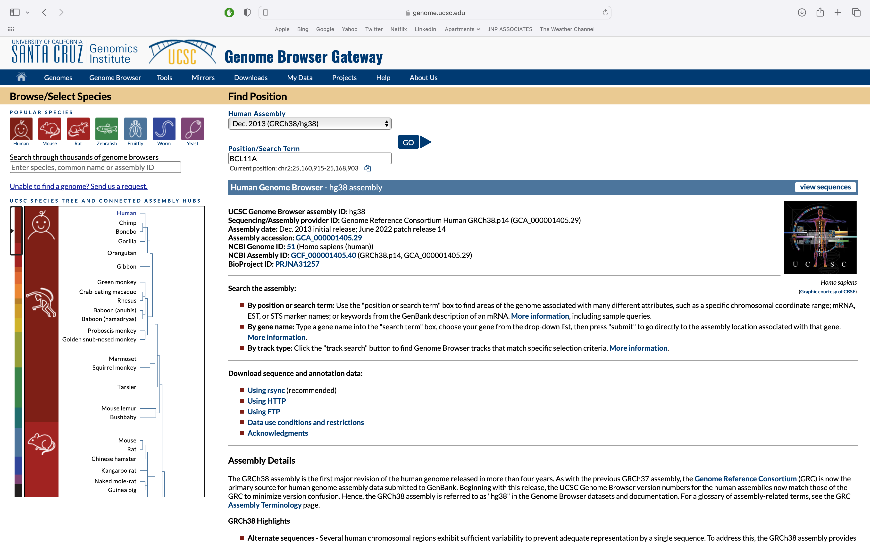
Use the hg38 assembly (ie version) of the human genome and enter BCL11A as the search term

Slide 6
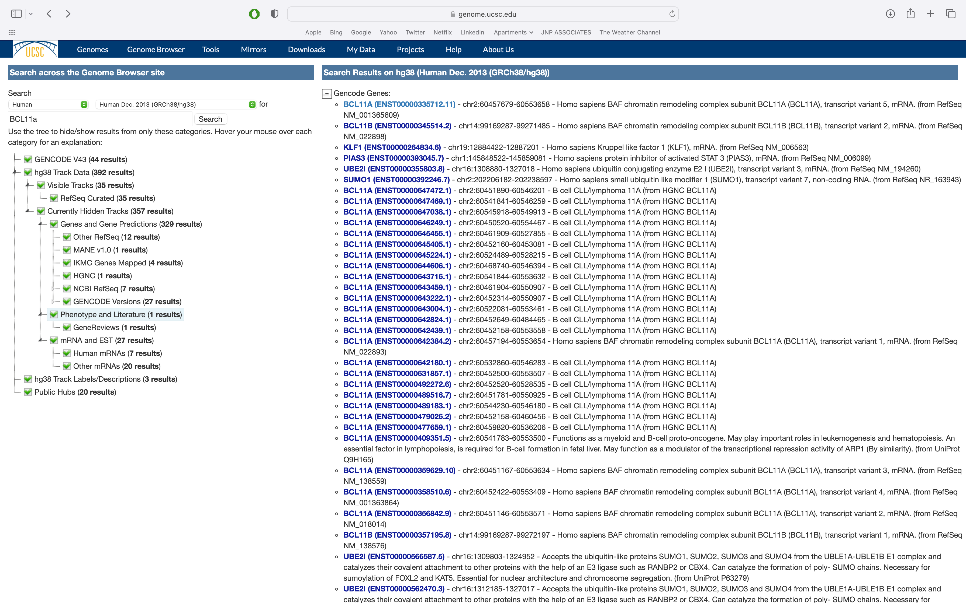
If your query has multiple matches be sure to select the correct one

Slide 7
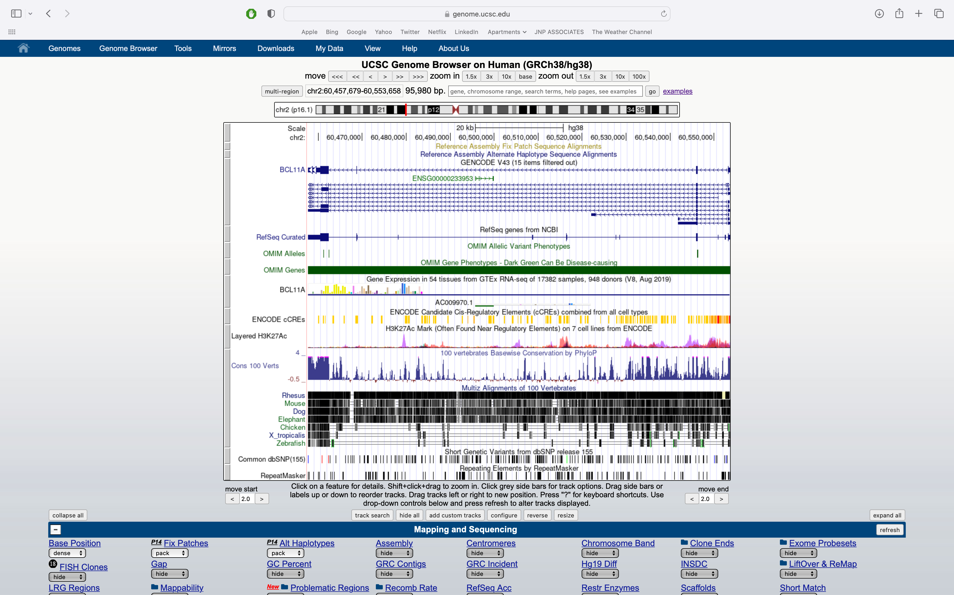
The default view of the BCL11A gene in the UCSC genome browser

Slide 8
The default view of the BCL11A gene in the UCSC genome browser
TOOLBAR
NAVIGATION CONTROLS
VIEW OF GENOMIC FEATURES
DISPLAY CONTROLS

Slide 9
The default view of the BCL11A gene in the UCSC genome browser
Each grey bar is a ‘track’.
The title of each track is centered in the browser.
Tracks are controlled below the browser.

Slide 10
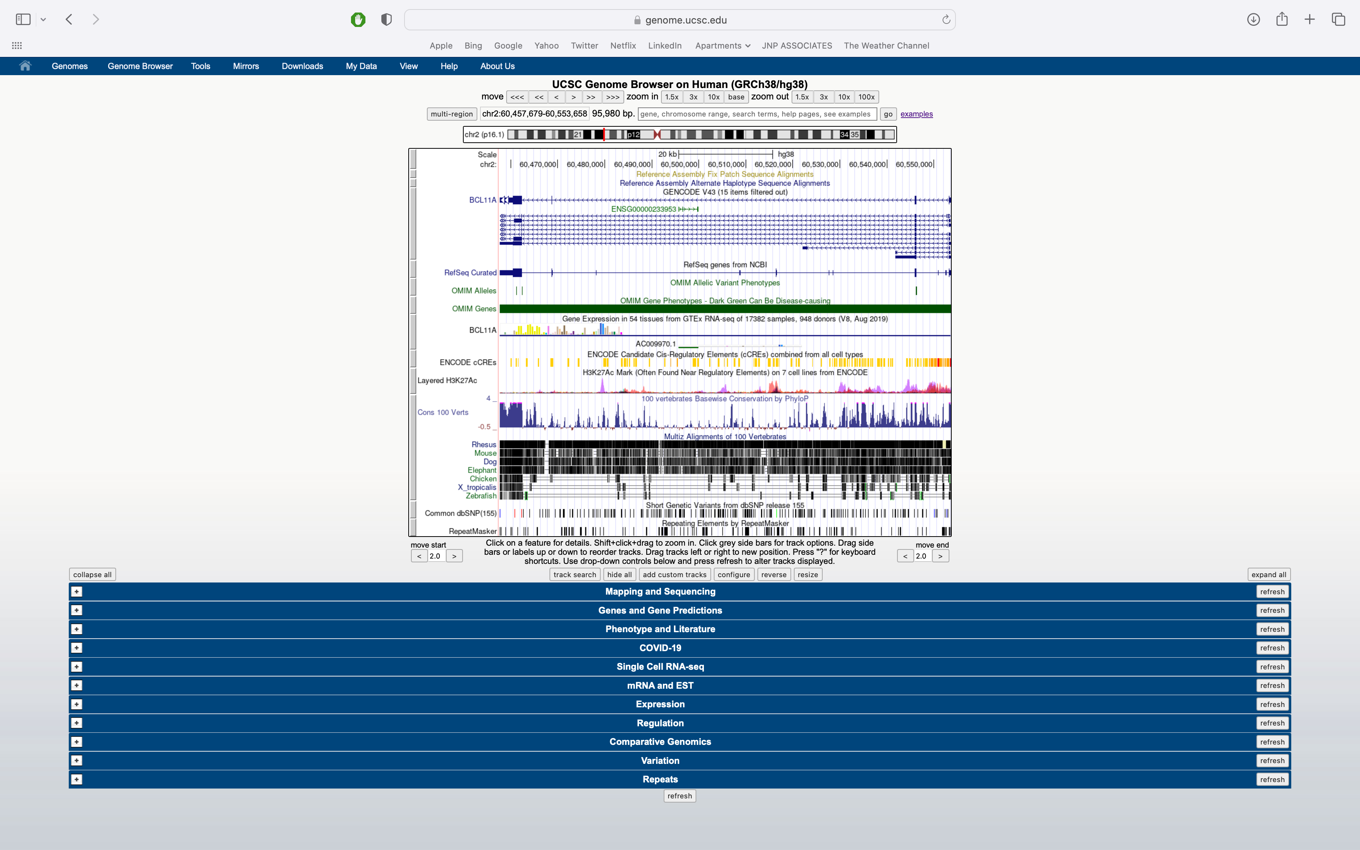
The full page
Each of the drop down menus(blue bars) allows for customizable visualization of tracks.
Data & annotations
Many options
Updates and new tracks occur semi-frequently

Slide 11
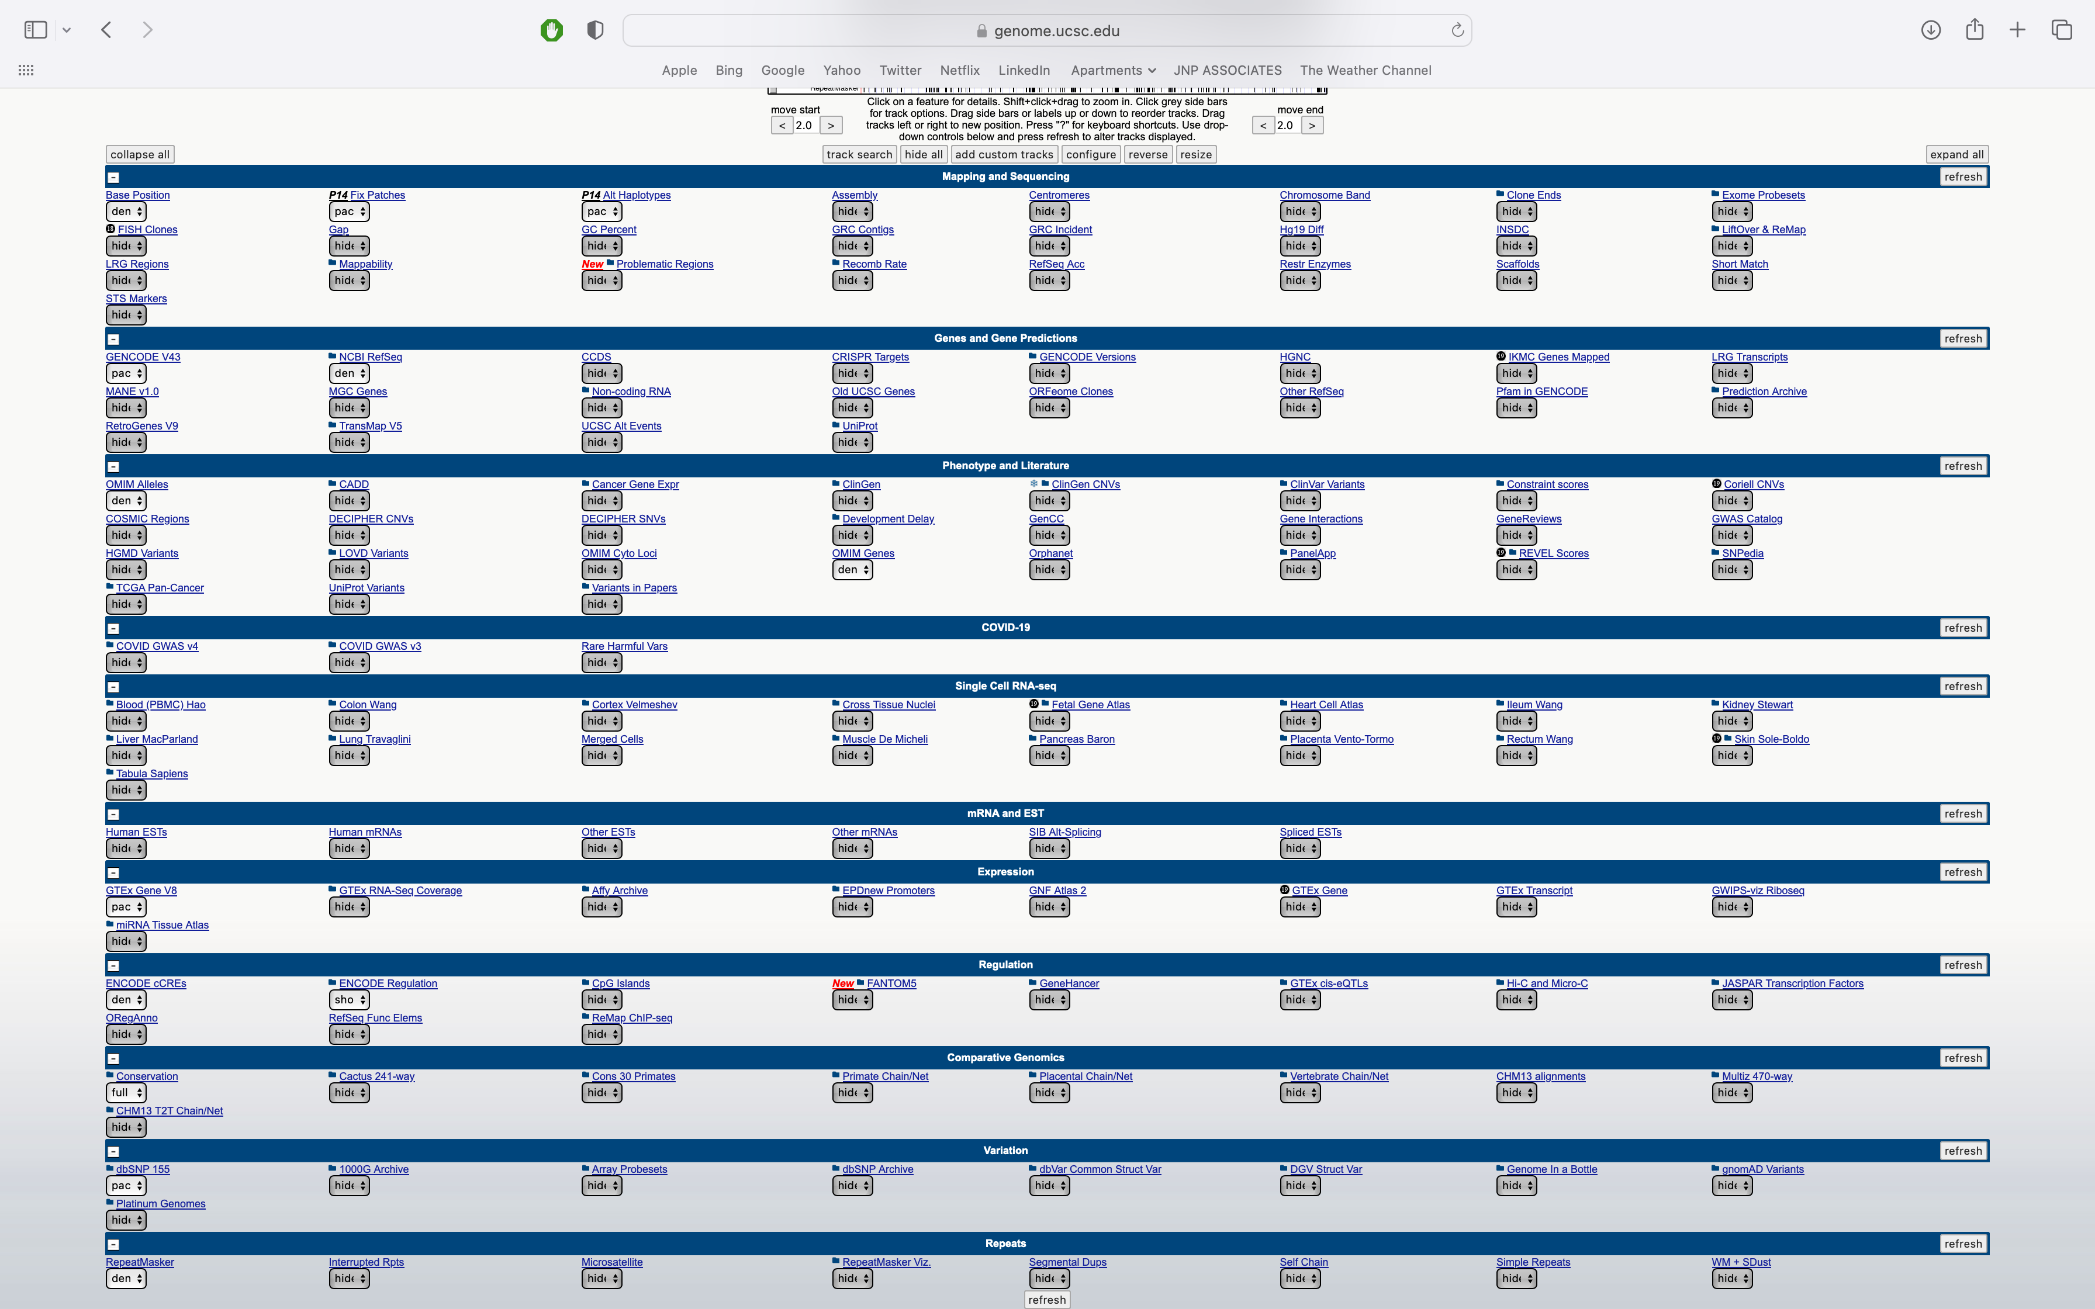
The full page – drop downs expanded

Slide 12
The full page – drop downs expanded
Each of the drop down menus(blue bars) allows for customizable visualization of tracks.
Data & annotations
Many options
Updates and new tracks occur semi-frequently

Slide 13
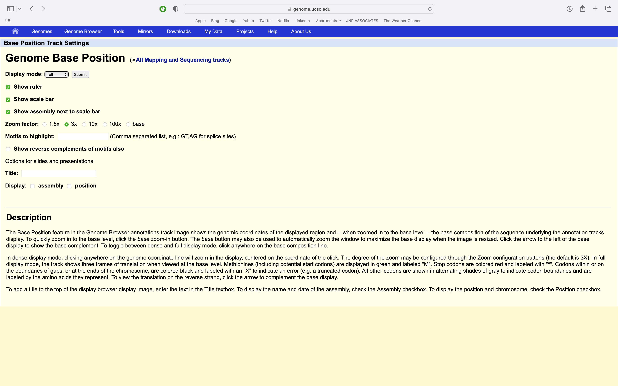
Genomic base position – detail page

Slide 14
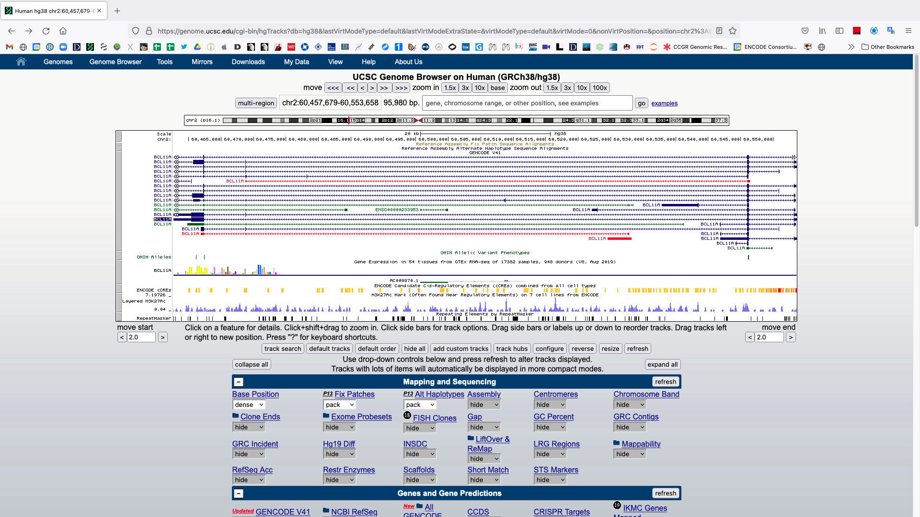
The default view of the BCL11A gene in the UCSC genome browser
Different gene models/isoforms
Most common isoform

Slide 15
Zoom out
Click here

Slide 16
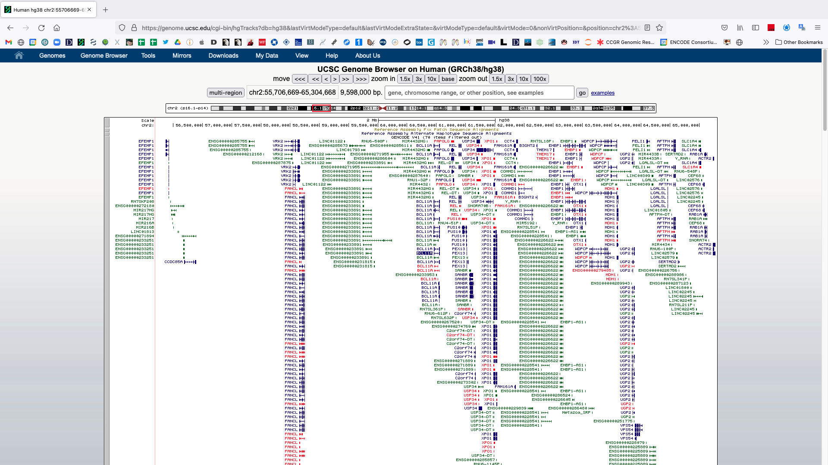
Many more genes can be observed when zoomed out

Slide 17
You can zoom in and out from 1 bp to a whole chromosome
Type in chr2:55,706,669 and hit ‘go’

Slide 18
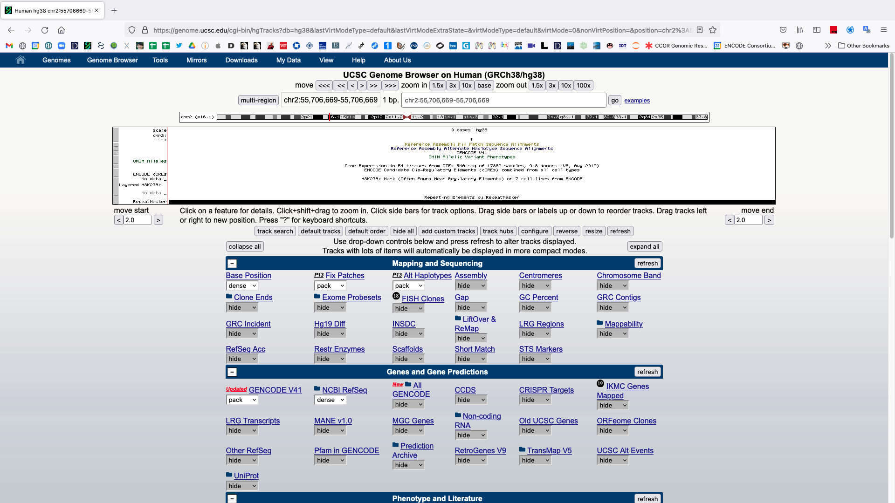
Single base
Notice how a one base pair coordinate position is represented
chr2 = chromosome 2
55,706,669 = this base is the 55,706,669th base on chr2
A single base pair (thymine)

Slide 19
Zoom out to three bases
Click here

Slide 20
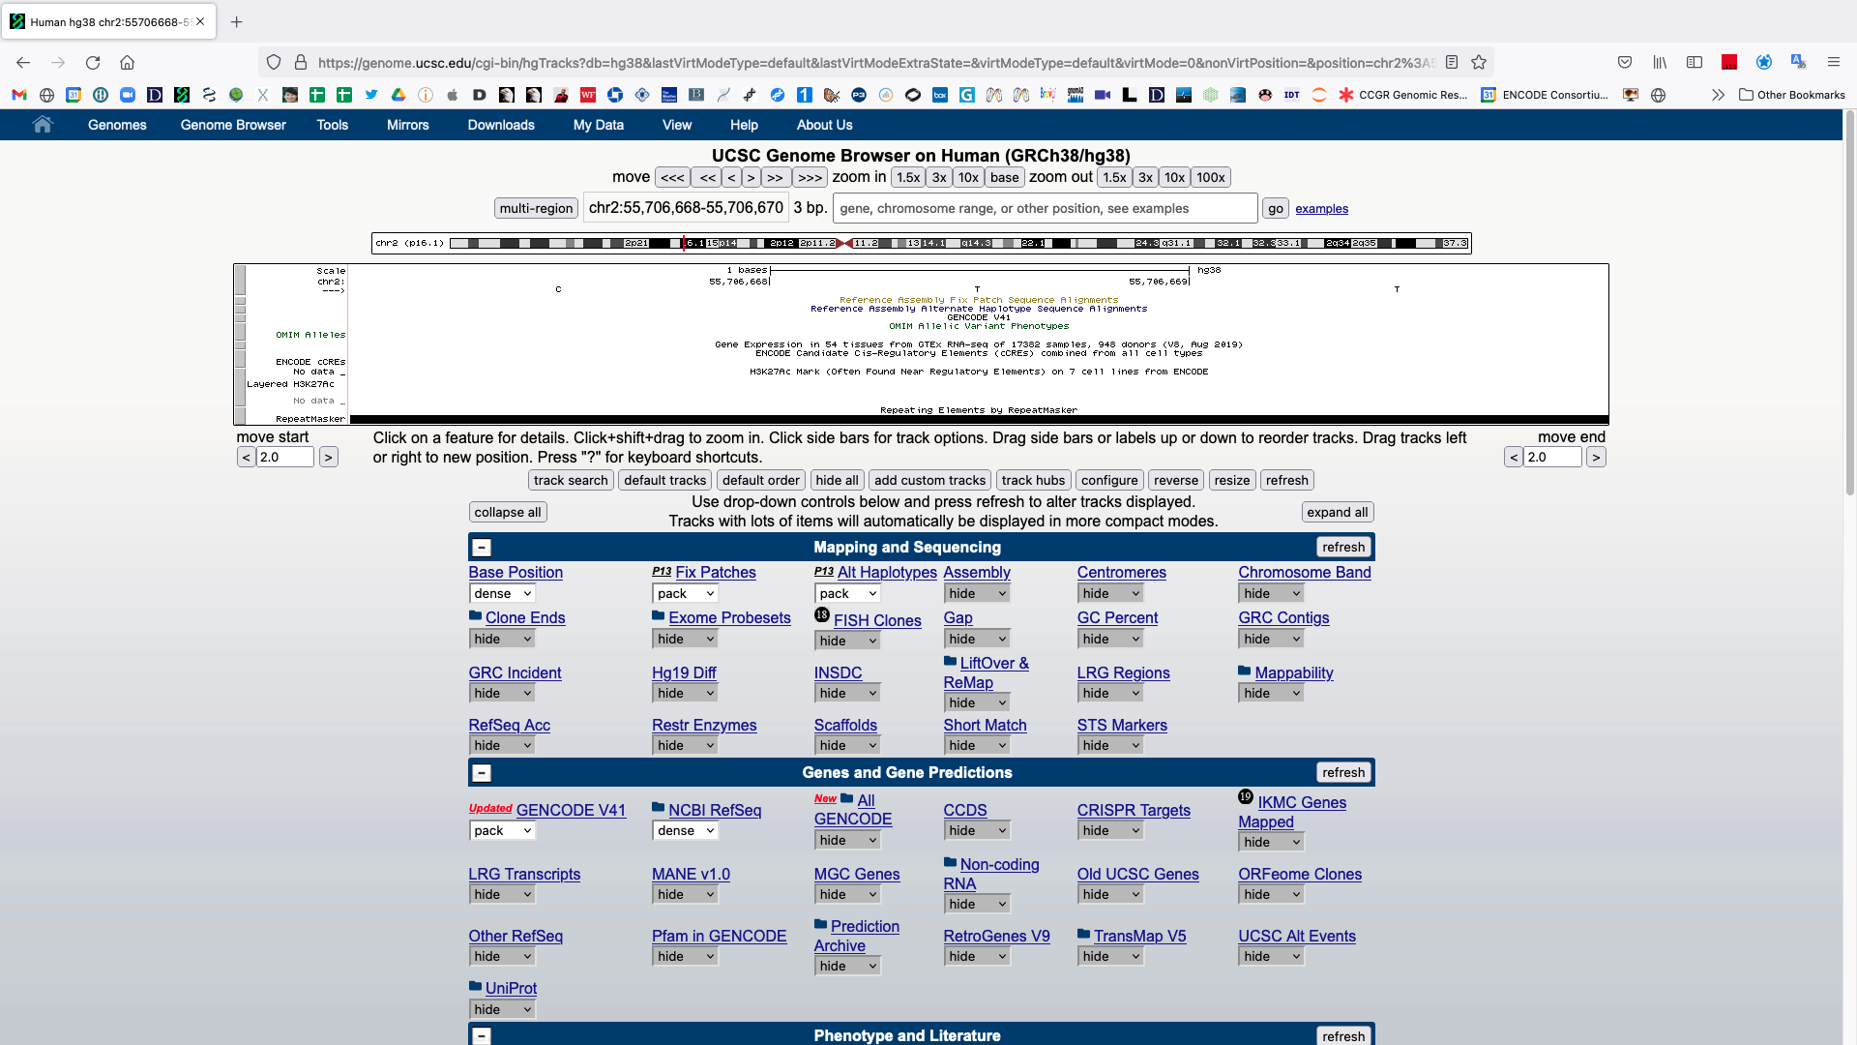
Notice how a coordinate position > 1 base pair (bp) is represented.
cytosine, thymine, thymine

Slide 21
Zoom out
Type in chr2 and hit ‘go’

Slide 22
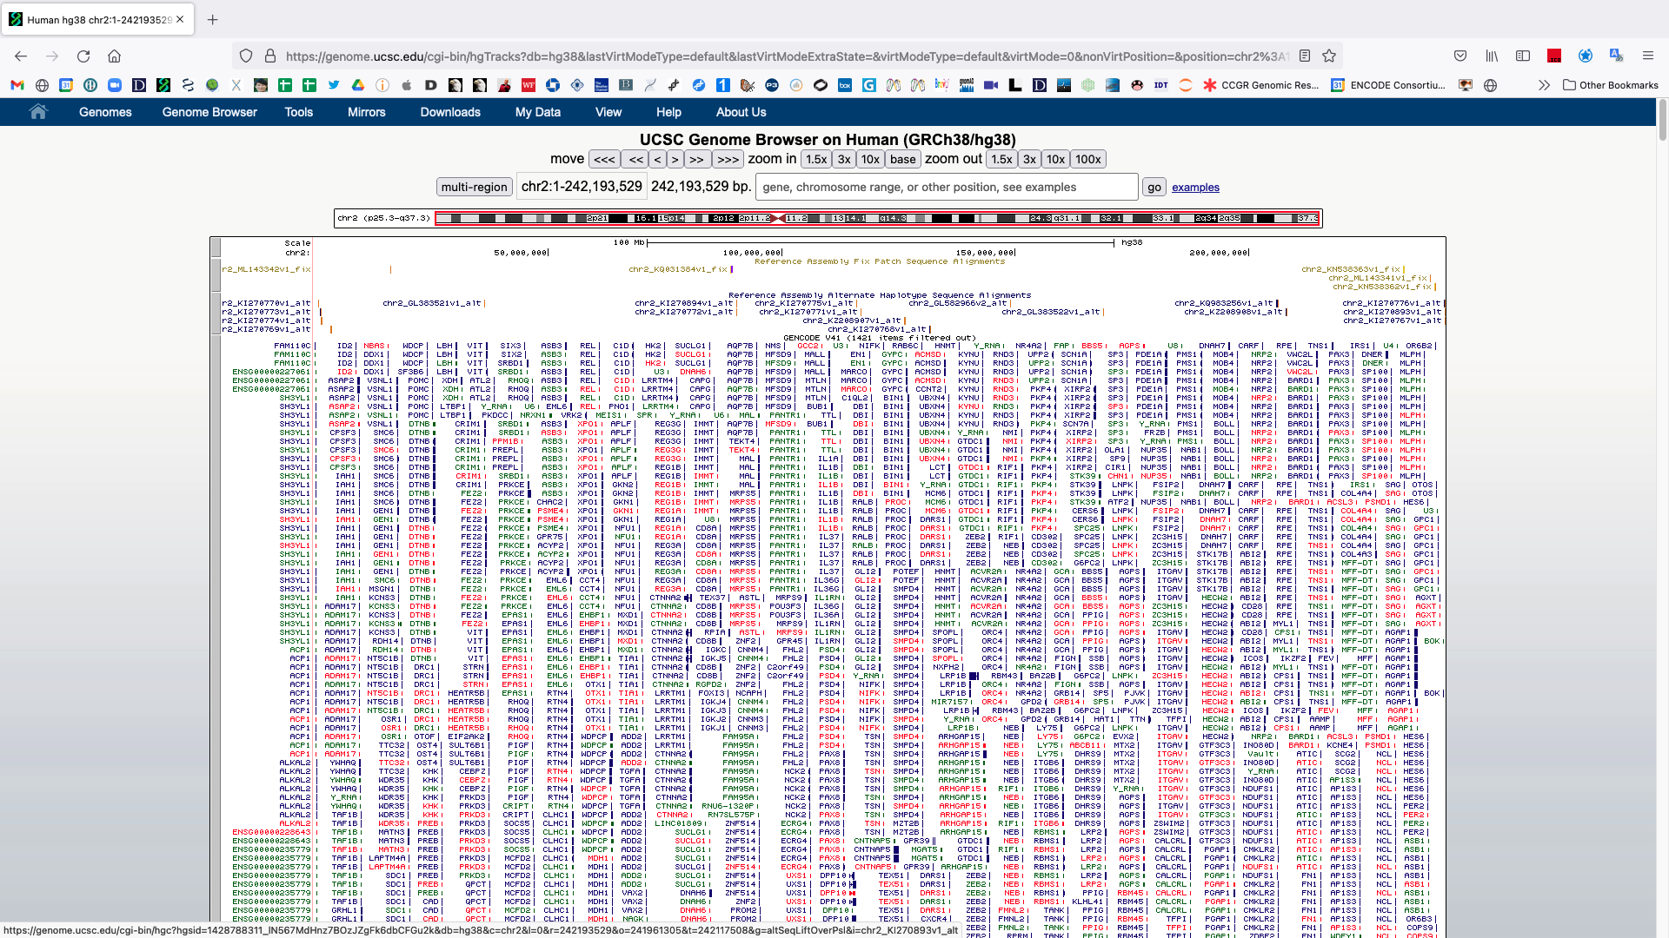
Chromosome 2
Notice the red box around the entire chromosome 2 ideogram
Too much information is being shown.
All known models for all genes on chr2.

Slide 23
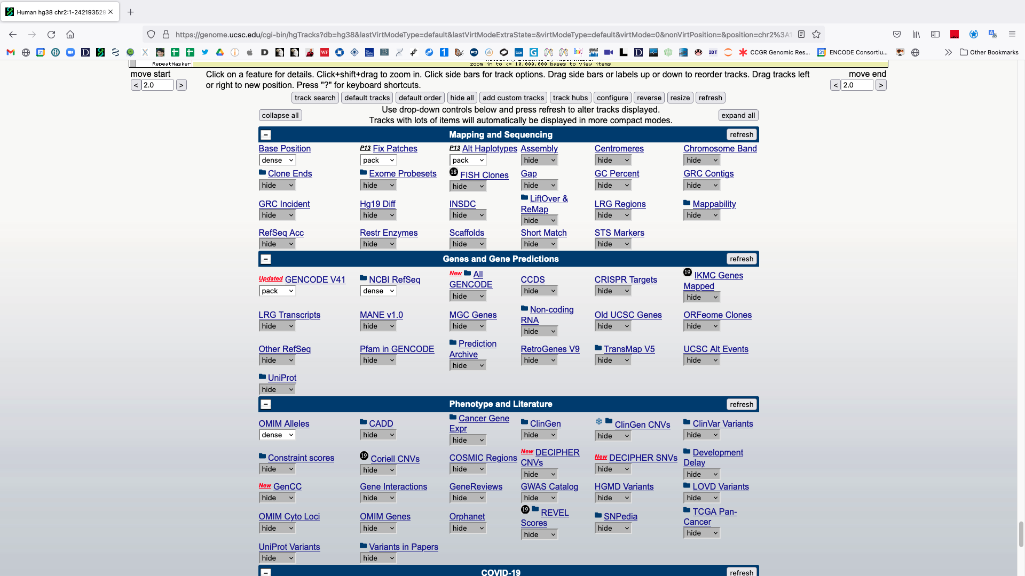
Adjust some settings
Scroll down and make the following changes:
GENCODE → squish
NCBI RefSeq → hide
OMIM Alleles → hide
GTEx Gene V8 → hide
Scroll down to find
After making the changes hit any ‘refresh’ button.

Slide 24
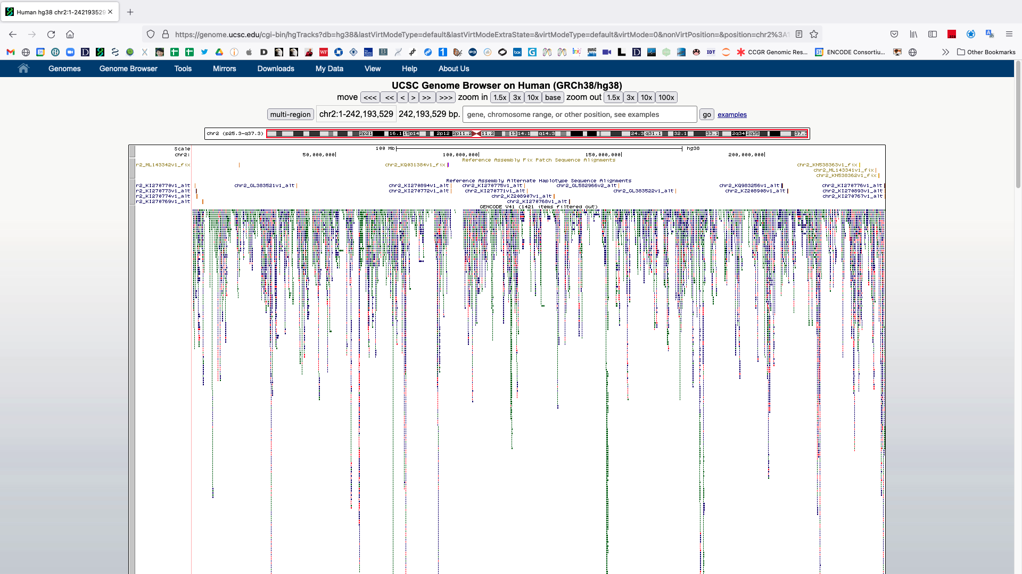
The gene models have been collapsed and other tracks removed (scroll down)

Slide 25
Tracks can be further modified by clicking on the grey bars to the left
Click on the GENCODE grey track bar

Slide 26
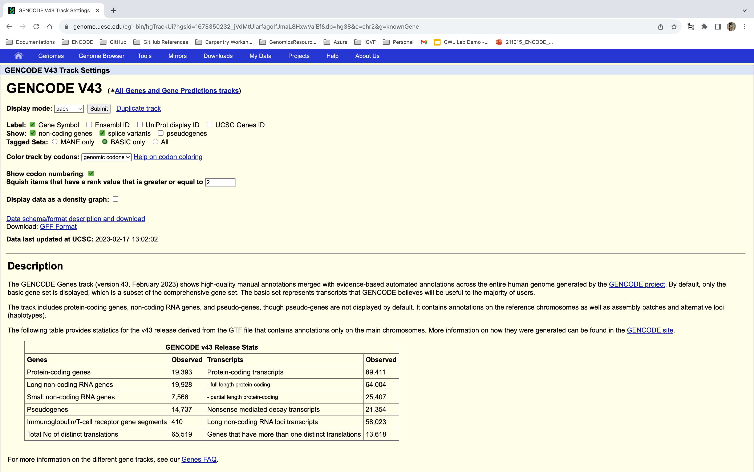
Track settings for the GENCODE track. These pages vary by track.

Slide 27
Change some options to hide data.
Click on “non-coding genes” and “splice variants” to hide the representation of these annotations.
Data visualization involves choices which impact interpretation, both yours and that of your audience.
Hiding these options can make interpreting data in a broad genome browser region more interpretable but removes information.
Hit ‘submit’ to see the changes.

Slide 28
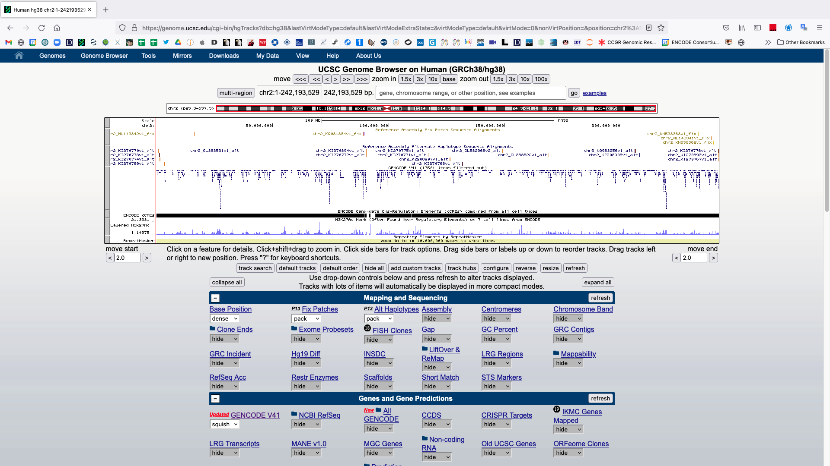
Now only a single model is shown for each gene. Return to BCL11A.
Type in BCL11A and hit ‘go’

Slide 29
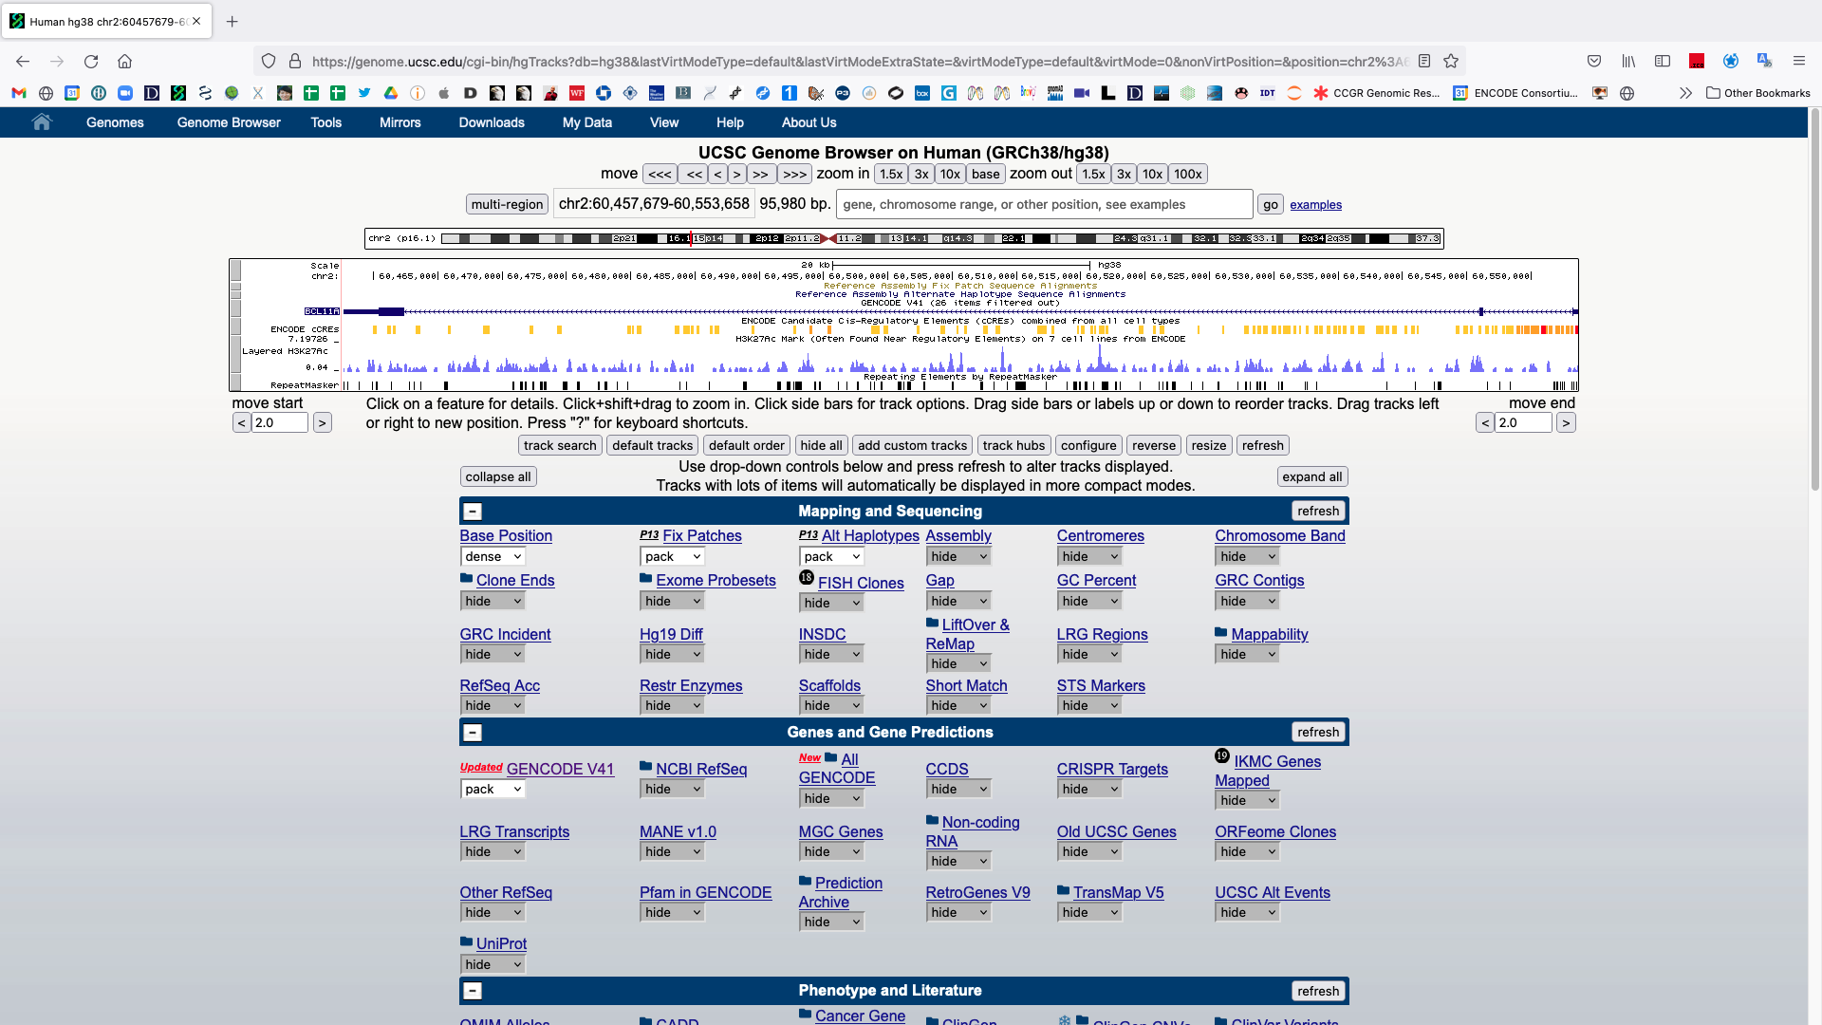
BCL11A & gene structure.

Slide 30
BCL11A & gene structure.
Notice the BCL11A’s position on chromosome 2
Ideogram (red vertical line)
chr:start-end coordinate
Exons are boxes
5' and 3' untranslated regions (UTRs) are thinner boxes
Introns are lines with arrowheads pointing in the direction of transcription

Slide 31
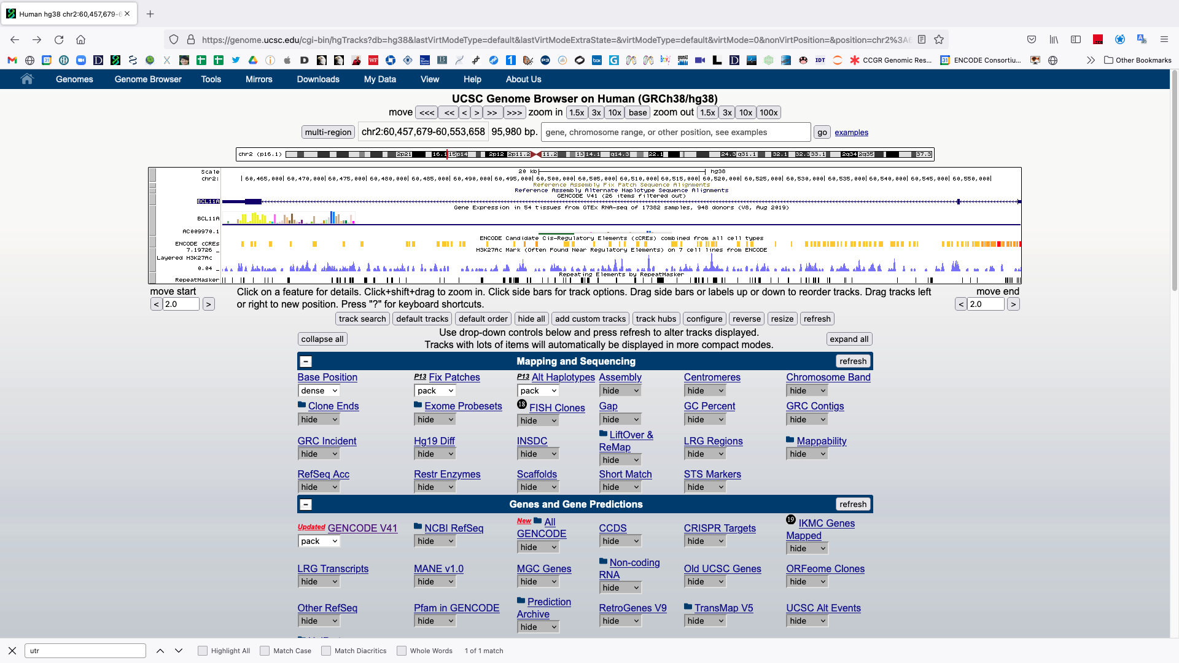
Scroll down and change the GTEX setting to ‘full’ and hit ‘refresh’.
Click the plot after refreshing
Change GTEx setting to “full”

Slide 32
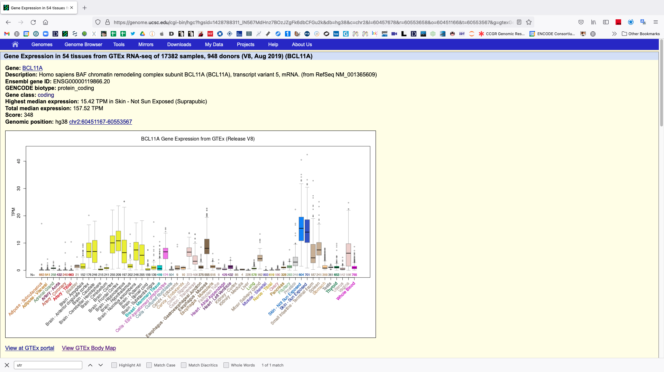
Primary tissue gene expression results from GTEX
TPM (Transcripts Per Million) is the most common unit for describing the abundance of a transcript.
Describes the amount relative to all other observed transcripts.

Slide 33
Anything else to add?

Slide 34
IGV Genome Browser
High-performance, easy to use, interactive tools for visual exploration of genomic data
Web app and desktop application is available: https://igv.org/

Slide 35
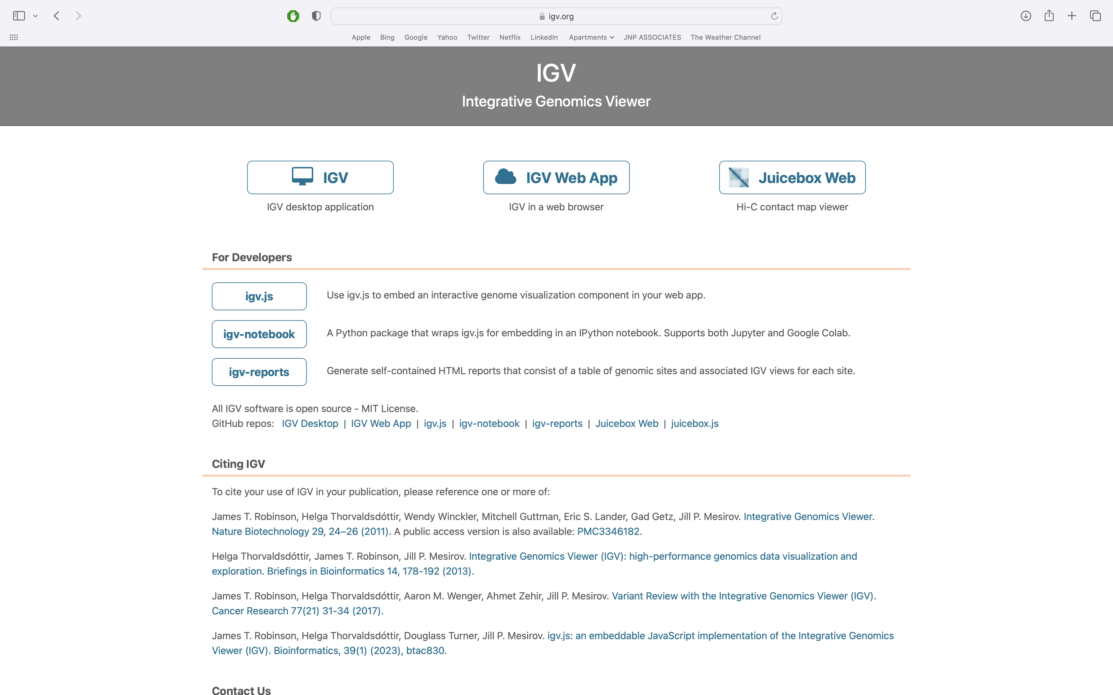
Landing page of IGV

Slide 36
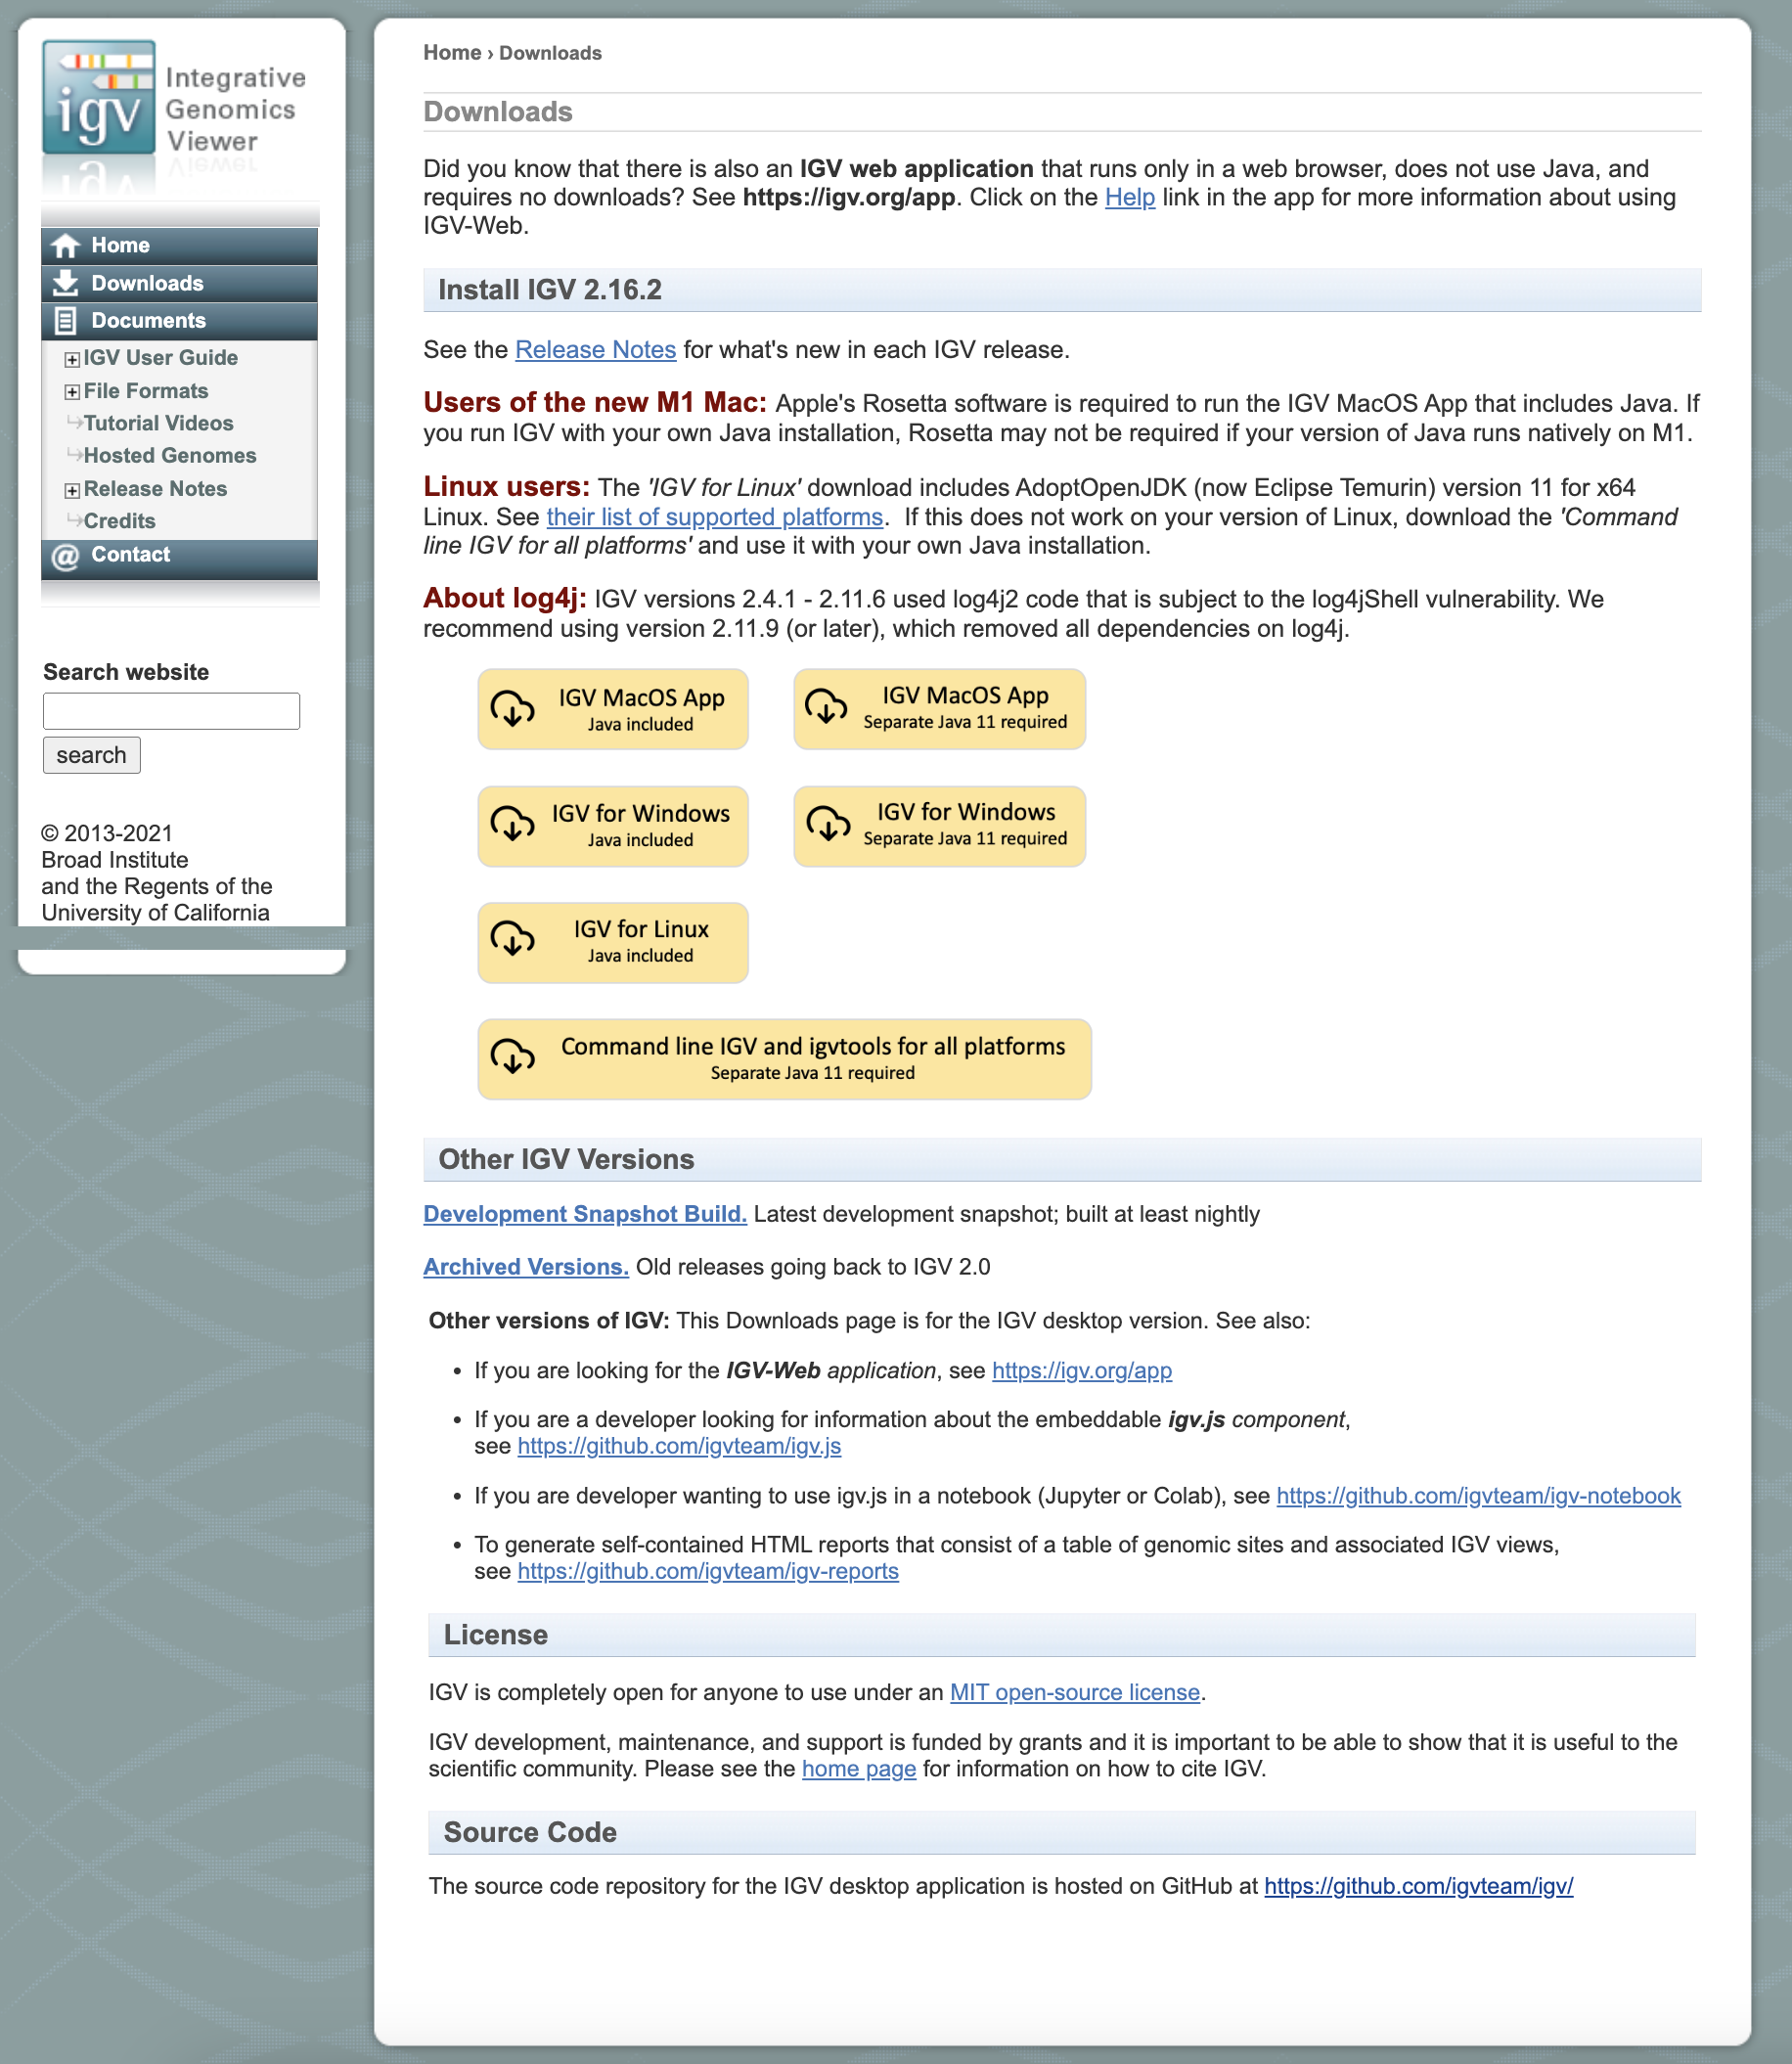
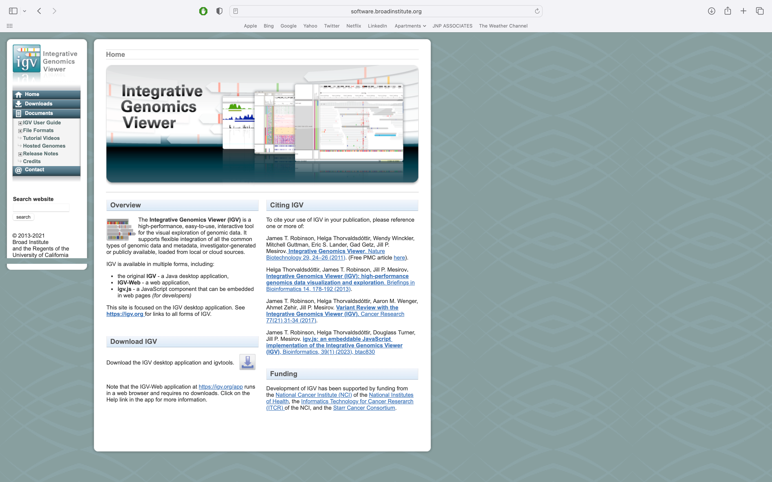
IGV Desktop Application:
The right installation for your system can be downloaded from here:

Slide 37
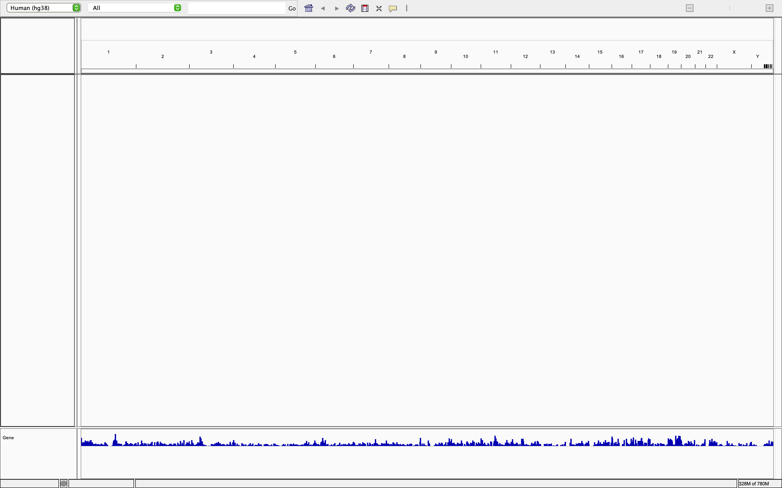
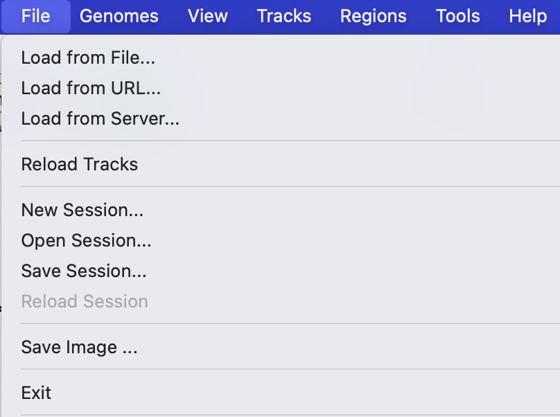
Desktop app landing page
Different visualization files (.bam, .bw, .bedGraph, .bed) can be loaded on to IGV from tool bar
Genome build
Chromosomes
Refseq genes

Slide 38
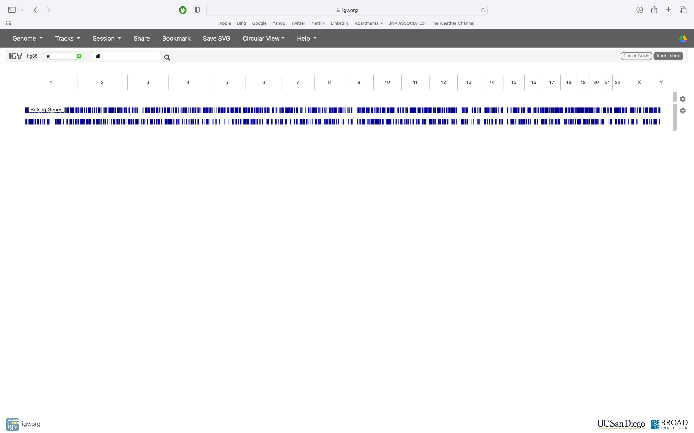
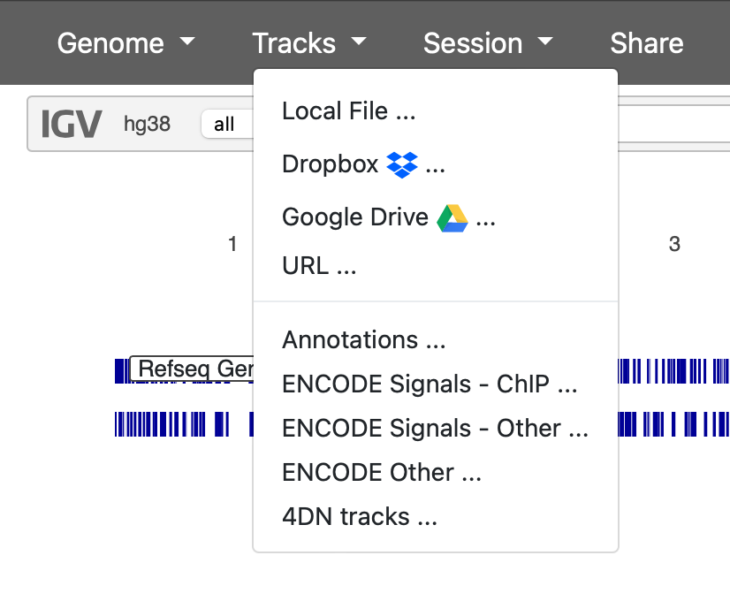
IGV Web App Landing page
Genome build
Tracks can be loaded from local, drive, dropbox or using URL
Chromosomes
Refseq genes

Slide 39
Exercises:
Load bams/bigWigs as track in UCSC and IGV and compare – need to identify relevant bams/bigWigs
Navigate across different genomic loci and at different zoom levels, from whole genome view and down to base-pair resolution
View the whole genome
Zoom into view one whole chromosome
Zoom in further to bp resolutions using the ruler
Download annotation files from UCSC genome browser
Download tracks from UCSC browser using TableBrowser

